Slide 1

Advanced Vehicle Collision Avoidance System

Slide 2
Team Members
Team Members
👤 Tanvir Ahmad
Email: tanvir.ahmad@ucdenver.edu
Phone: 720.940.4699
👤 Anh-Huy Dinh
Email: anh-huy.2.dinh@ucdenver.edu
Phone: 303.587.5168
Deep Learning Spring 2025 - Final Project
University of Colorado Denver

Slide 3

System Architecture
Dashcam Video
Object Detection
YOLOv11
Lane Detection
Ultrafast Lane Detector
Distance Estimation
Single Cam Distance Measure
Visualization System
Warning
Key Components
YOLOv11 for object detection and tracking
Ultrafast Lane Detector for lane identification
Single Cam Distance Measure for distance calculation
Real-time visualization
Flow of Information
Video input from dashcam
Parallel processing of frames
Integration of detection results
Visual and warning outputs

Slide 4



Lane Detection Enhancements
Original Implementation
Our Enhanced Version
# Original culane_row_anchor (18 points) culane_row_anchor = [ 121, 131, 141, 150, 160, 170, 180, 189, 199, 209, 219, 228, 238, 248, 258, 267, 277, 287
]
# Original griding number
self.griding_num = 200
# Enhanced culane_row_anchor (39 points)
culane_row_anchor = [
100, 105, 110, 115, 120, 125, 130, 135,
140, 145, 150, 155, 160, 165, 170, 175,
180, 185, 190, 195, 200, 205, 210, 215,
220, 225, 230, 235, 240, 245, 250, 255,
260, 265, 270, 275, 280, 285, 287
]
# Enhanced griding number
self.griding_num = 400
Key Improvements
More Row Anchors
Increased from 18 to 39 points for finer vertical resolution, enabling better detection of curved lanes and complex road geometries.
Higher Griding Number
Doubled from 200 to 400 for more horizontal precision, resulting in smoother lane detection and more accurate lane positioning.

Slide 5
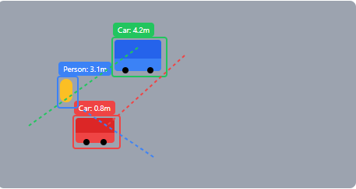
Object Detection & Tracking
# YOLOv11 detection with tracking
results = yolo_model.track(
frame,
conf=0.5,
# Detect these classes:
classes=[0, 1, 2, 3, 5, 6], # car, truck, bus,
# person, motorcycle, bicycle
persist=True,
tracker="bytetrack.yaml"
)
# Process tracking info
for box in results[0].boxes:
# Get class ID and name
cls_id = int(box.cls.item())
class_name = class_names.get(cls_id, "unknown")
# Process tracking info
if box.id is not None:
track_id = int(box.id.item())
current_ids.add(track_id)
# Get bounding box
x1, y1, x2, y2 = map(int, box.xyxy[0].tolist())
# Add centroid to trajectory history
centroid_x = (x1 + x2) // 2
centroid_y = (y1 + y2) // 2
trajectory_history[track_id].append(
(centroid_x, centroid_y)
)
YOLOv11 Implementation
Key Features
Object Classes
Cars, trucks, buses, pedestrians, motorcycles, bicycles
Tracking
ByteTrack for persistent object ID maintenance

Slide 6
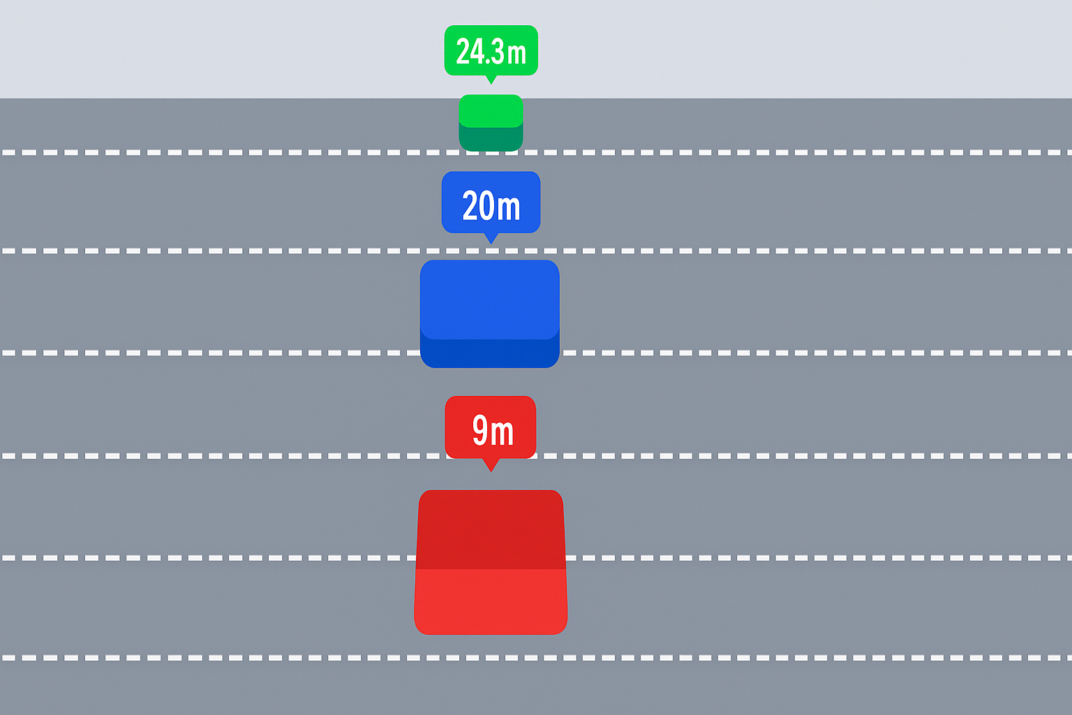
Distance Estimation
Implementation
class SingleCamDistanceMeasure:
def updateDistance(self, rect_infos):
"""Update distances for detected objects
Args:
rect_infos: List of RectInfo objects with
bounding boxes
"""
# Process each detected object
for rect_info in rect_infos:
# Extract bottom center of bounding box
bottom_center_x = (rect_info.x1 + rect_info.x2) // 2
bottom_center_y = rect_info.y2
# Calculate distance based on object type
# and position
distance = self.calculate_distance(
rect_info.label,
bottom_center_x,
bottom_center_y
)
# Store distance with track_id for visualization
self.distance_by_track_id[rect_info.track_id] = distance
# Record distance point for visualization
self.distance_points.append(
(bottom_center_x, bottom_center_y, distance)
)
Key Features
Monocular approach: Uses a single camera for distance estimation
Object-specific calibration: Different calculations based on object type (car, truck, person)
Real-time processing: Fast computation for immediate warnings
Integration with tracking: Maintains distance history for trajectory prediction

Slide 7
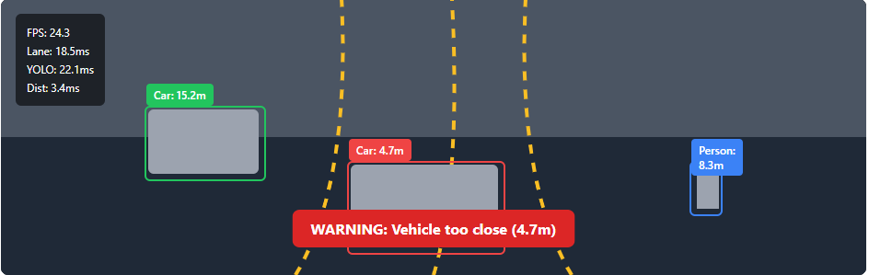
System Demonstration
Key Features
Real-time object detection and tracking
Accurate lane detection even on curved roads
Distance-based color-coded warnings
Performance metrics overlay
Performance
24.3 FPS on NVIDIA RTX 3080
Lane detection: 18.5 ms
YOLO detection: 22.1 ms
Distance estimation: 3.4 ms

Slide 8
Limitations & Future Work
Current Limitations
Lighting conditions: Distance estimation accuracy decreases in poor lighting
Weather sensitivity: Performance degrades in extreme weather (heavy rain, snow)
Computational demands: Requires dedicated GPU hardware for real-time performance
Fixed calibration: System needs recalibration for different camera setups
Future Extensions
Vehicle CAN bus integration: For automated emergency braking
Multi-camera setup: Enhanced distance accuracy with stereo vision
Edge optimization: Deployment on embedded automotive systems
Night vision: Infrared capabilities for low-light conditions

Slide 9
Elevator Pitch
"Imagine cutting vehicle accidents by a third with just a simple dashcam upgrade. Our AVCAS system turns ordinary dashcams into smart safety assistants that warn drivers before collisions happen—even mimicking features found in autonomous vehicles."
Unlike expensive systems that only come in new luxury cars, our software works with existing hardware and can be installed across vehicle fleets right away. AVCAS bridges the gap between legacy vehicles and self-driving technology by delivering real-time lane, object, and risk detection using AI.
We're targeting delivery and trucking companies with a $200 per vehicle subscription that pays for itself within months through fewer accidents and lower insurance costs. Our initial testing with local delivery services showed a 22% reduction in near-misses. With hundreds of millions of dashcams already on roads worldwide, AVCAS brings autonomous-grade safety to everyone—not just those with the newest vehicles.
Target Market
Commercial fleet operators (delivery, trucking)
Insurance companies offering discounts for safety tech
Autonomous vehicle integrators seeking modular safety systems
Aftermarket automotive accessory manufacturers
Consumer dashcam manufacturers for integration
Business Model
B2B subscription: $200 per vehicle annually
ROI for customers: 3-6 months through accident reduction
Software-as-a-service with regular AI model updates
Enterprise tier with fleet management dashboard and AV-readiness analytics

Slide 10
Thank you….
Any Questions???!!!!
Feel Free to contact………….
Tanvir Ahmad
Email: tanvir.ahmad@ucdenver.edu
Phone: 720.940.4699
Anh-Huy Dinh
Email: anh-huy.2.dinh@ucdenver.edu
Phone: 303.587.5168

